Slide 1

E-Library Semantic Search

Slide 2
Team Member:
Mohamed Ashraf
Mohamed Shawkey
Mahmoud Al Soudy
21-01148
21-01287
21-00911
Maryam Hossam Eldin
Renad Abdelrahman
Selvana Atef
21-01043
21-01500
21-01588
Bahaa Mahmoud
21-00550

Slide 3
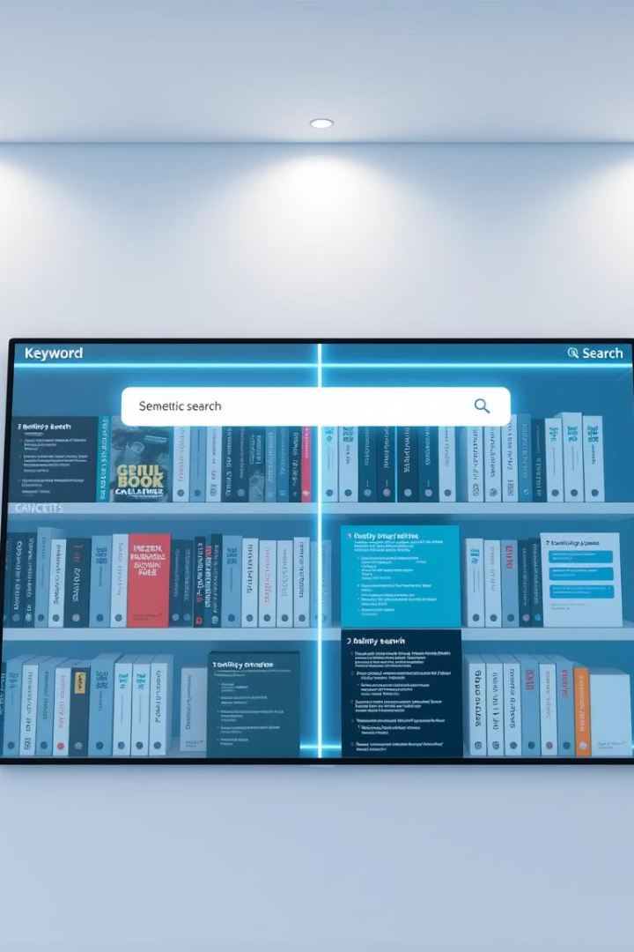
Introduction
Traditional digital libraries use keyword-based search.
This method often fails to understand the user's intent.
Our project introduces a semantic search engine based on ontology for programming resources.
Goal: Smarter search that understands meaning, not just words.

Slide 4

Problem Statement
Irrelevant Results
Context Blindness
Keyword systems return irrelevant or generic results.
They don't recognize context (e.g., "beginner Python books").
Time Waste
Language Gap
Users spend more time searching than learning.
There's a gap between query language and resource understanding.

Slide 5





Project Objectives
Design an OWL-based ontology for programming resources.
Enable semantic queries using SPARQL.
Improve accuracy and relevance of search results.
Demonstrate real-world applications for education and development.

Slide 6
Methodology 1 – Ontology Design & Relationship Modeling
Ontology Design
Relationship Modeling
Built using Protégé.
Defined object properties:
Defined classes:
hasAuthor, publishedBy, coversTopic,
ProgrammingBook, Tutorial, Author, Publisher,
teachesLanguage, hasDifficultyLevel.
ProgrammingLanguage, Topic, DifficultyLevel.
Creates a semantic network of library resources.

Slide 7



Methodology 2 – Implementation & Querying
Implementation
Ontology validated and exported in OWL format.
Data Loading
Data loaded into Apache Jena Fuseki for SPARQL querying.
Querying
Used SPARQL to retrieve meaningful information.
Example: Find beginner tutorials teaching Python.
Ensures context-aware search.

Slide 8








System Integration
Java Application
User Interface
Integrated with NetBeans
Search using SPARQL
Backend Connection
Results Display
Connects via Apache Jena
View semantic results

Slide 9
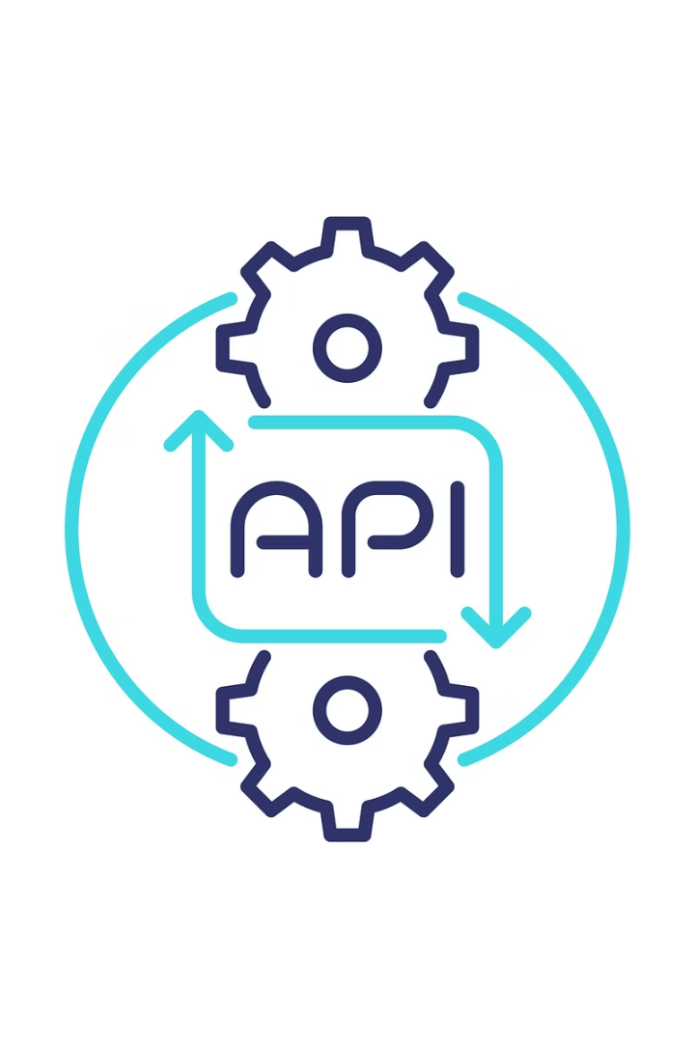




API Implementation
Custom Java API
Load & Parse OWL
Developed to handle ontology operations
Processes ontology structure
Run Dynamic SPARQL
Display in GUI
Executes semantic queries
Shows results to users
Utilized Apache Jena API for model handling & query execution.

Slide 10













Ontology Classes
Tutorial
ProgrammingBook
Instructional content
Reference materials for programming
Author
DifficultyLevel
Content creators
Content complexity
Publisher
Publishing entities
Topic
ProgrammingLanguage
Subject areas
Languages covered
Each class represents a key concept in the semantic structure.

Slide 11
Ontology Properties
Property
Relationship
hasAuthor
Connects books with authors
publishedBy
Connects books to publishers
coversTopic
Links resources to topics
teachesLanguage
Specifies the language taught
hasDifficultyLevel
Classifies material by difficulty

Slide 12
Sample SPARQL Query
Query Objective: Find beginner tutorials that teach Python
SELECT ?tutorial
WHERE {
?tutorial rdf:type :Tutorial .
?tutorial :teachesLanguage :Python .
?tutorial :hasDifficultyLevel :Beginner .
}
This returns only relevant and contextual results.

Slide 13
Real-World Impact
Improves accessibility of programming resources.
1
2
Saves time by returning more relevant results.
Useful in university e-libraries and online platforms.
3
4
Supports personalized learning paths and smart recommendations.

Slide 14



Tools & Technologies Used
Protégé – Ontology creation
OWL, RDF, SPARQL – Semantic Web Standards
Apache Jena – Java API for ontology integration
NetBeans – Java Development Environment
SPARQL Endpoints – For querying the ontology

Slide 15
Results
1
Fully functional semantic search system
2
Clean Java GUI integrated with semantic backend
3
Context-aware results retrieved efficiently
4
Users can now search programmatically with meaning

Slide 16
Conclusion
The project demonstrates how semantic web technologies improve information retrieval.
Bridges the gap between user intent and library data.
Helps in building smarter, more intuitive e-learning platforms.
Sets a foundation for future work in AI-driven educational tools.

Slide 17
Thanks For Listening
Any Questions..?

